Slide 1
Ceramics Network
By: Broken Ceramics
Topic: Data Collection and Data Analysis (Information Gathering Online source and Practical)

Slide 2
Submitted To:
Mr. Nazmus Sakib
Abdullah Al Jobayer Imran
Group Members:
Abu Khalid 11.01.04.021
Farzana Sabah 11.01.04.027
Sumaiya Bushra 11.01.04.028
Rasif Tahmid Islam 11.01.04.011

Slide 3

What is involved in collecting data???
Identify issues and/or opportunities for collecting data
Select issue(s) and/or opportunity(ies) and set
Plan an approach and methods
Analyze and interpret data
Collect data
Act on results

Slide 4

Data Collection & Analysis Method
Interviewing
A direct conversation with a person on a specific subject
‘Open ended questions’ along with few closed questions

Slide 5

Data Collection & Analysis Method
Qualitative Analysis
Organize data
Identity Frameworks
Sort data in to framework
Use framework for descriptive analysis
Second Order Analysis

Slide 6
Objectives of Data Collection
Knowing the current industry status
Seeking the opinion and goals of the interviewee
Current decision making style
Exploring HCI concerns
The problems they are facing for the current system
How useful our new system will be for them

Slide 7



Objectives of Interview
Birds eye view of the current situation of ceramics industries of Bangladesh
Collecting official data from executives of a company
Accuracy of information

Slide 8
Questionnaires and Interview pattern
Question Pattern
Open ended questions
Descriptive answers
Question Topics
web based platform in ceramics industries
technologies used in the marketing process of ceramics
Technology using in Bangladeshi ceramics industries
ceramics market in one platform

Slide 9
Questionnaires and Interview pattern
Interview Pattern
Web
based
platform in
Ceramics industry
technologies used in the marketing process of ceramics
All the companies in one big platform
Pyramid structure
Starts with close ended questions but finishes with open ended questions
Broad data can be found to analyze

Slide 10
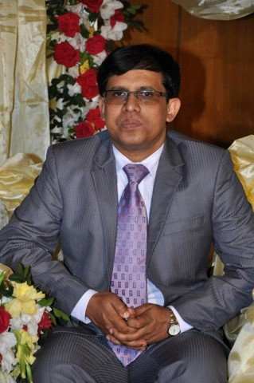

Whom are we taking the Interview???
It is our pleasure to have with us such a person who can brought up the whole scenario of ceramics industry
As a Chief Operating Officer he can clarify to us what problems may arise to build such a web platform to bring all the rival under one hood
He can notify us what type of environment is really liked by the foreign delegates in terms of business
Rizvi-Ul-Kabir Chief Operating Officer Shinepukur Ceramics Limited & General secretary of Bangladesh Ceramic Ware Manufacturers Association(BCWMA)

Slide 11

Show Time ! ! !
Let’s Rock

Slide 13
ANY QUESTION???

